Slide 1
TRANSITIONING TO COLLEGE LIFE
Chapter 2

Slide 2
CHAPTER OBJECTIVES
Recognize the difference between the high school and college experience.
List strategies for a satisfying and successful transition to the university setting.
Determine your learning style.
Demonstrate effective study and test-taking skills.
Define and demonstrate critical thinking skills.

Slide 3

Let’s Reflect…
Starting college can be a scary and anxious experience. What were some of the fear you had (or still have) about college life?

Slide 4

What freshmen fear the most…
Am I smart enough?
Will my roommate be weird?
Will I make friends?
What do I do when I get home-sick?
Will I be safe on-campus/in Ruston?
Will I have enough money?
How do I balance school/jobs/organizations and other commitments.

Slide 5
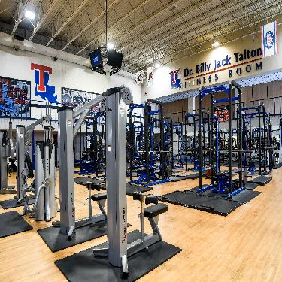
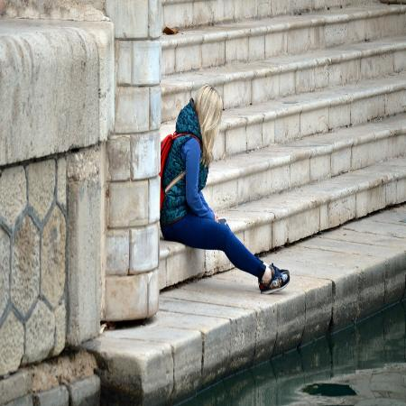

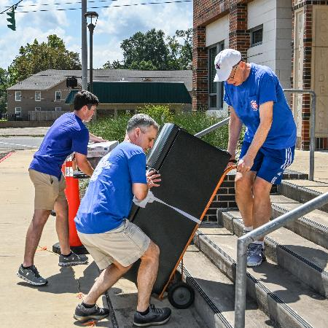
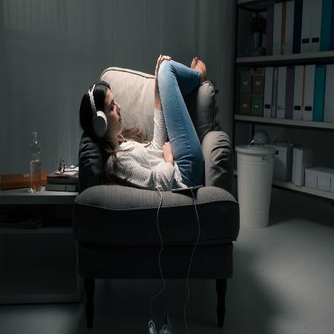

Taking Care of YOU
Work on your physical health
Homesickness & Loneliness is NORMAL
Stay organized
Get involved on campus/in the community
Find healthy ways to manage stress
Prioritize your sleep

Slide 6
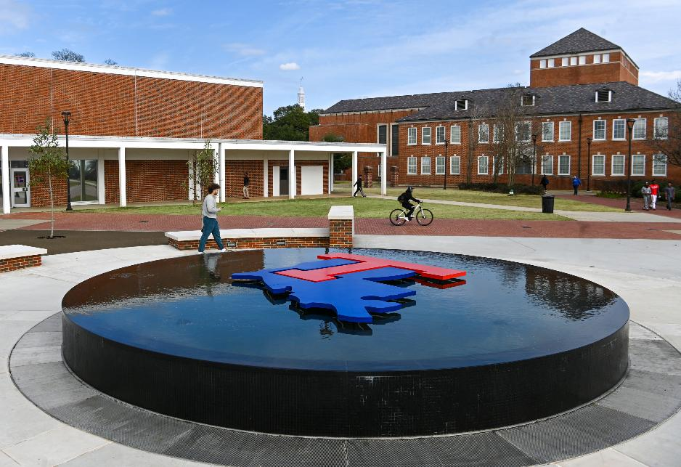
Goodbye High School
So far, what has been the biggest difference between your experience in high school, and your time so far at Louisiana Tech?

Slide 7
NAVIGATING THE TRANSITION
Grow into your autonomy
With increased independence can come with a newfound sense of freedom as well as more responsibility. Find ways to embrace the autonomy and not trapped by it.
Embrace the pace
The quarter system moves fast. Take time to plan a schedule and stick to it. Get engaged and involved but know your limits and get ready for the first quarter (and freshman year) to FLY by.
Grow into your autonomy
You are the manager
How you spend your day is your decision. Parents won’t be waking you up, cleaning your room, or cooking you every meal. Control is yours, be sure to take care of yourself!

Slide 8
NAVIGATING THE TRANSITION
Building relationships
While some of your high school friends may be at Tech with you, the reality is you have an opportunity to build and develop many new relationships with roommates, coworkers, classmates, and instructors, advisors, and more across campus.
Opportunities in cultural diversity
Louisiana Tech is rich in diversity. With students from across the state, the country, and the globe, you will have the chance to meet someway quite different from yourself. Take the time to find someone with a different background and expand your circle.
Become a critical thinker
In the university setting, you will be expected to achieve a higher level of learning by thinking critically. From ensuring you are taking in accurate and reliable information to applying it appropriate, the responsibility is yours.

Slide 9
10 Steps to Getting Good Grades in College…
Attend every class – including review days, discussions, etc.
Be organized – keep a planner
Manage your time well – do not overextend yourself
Be successful in class – prepare for class and be on time
Take good notes – pay attention and actively listen
Learn how to read a textbook – scan, read, and review
Study smarter – know your learning style, don’t cram
Use test-taking strategies – develop a plan and don’t panic.
Reduce test anxiety – study to build confidence and get sleep
Use available resources – tutoring, study groups, instructors

Slide 10

Tips for learning, by style:
VISUAL
Underline, use different colors, use symbols and charts.
Recall the pictures from your notes, draw diagrams, turn visuals into words.
AUDITORY
Discuss topics with other students, record the lectures
Record note summaries and play them back.
READ/WRITE
Use lists and headings, use dictionaries and handouts.
Rewrite your notes, paraphrase texts.
KINESTHETIC
Use senses, use trial-and-error methods, listen to real-life examples and use hands on approaches.
Write practice answers, role play situations.

Slide 11
Time Management Activity (2.1)
Use the time management chart in the appendix of your FYE Textbook and complete a calendar for next week. Include class times, assignments, exams, organization meetings, job responsibilities, sleep, meals, and exercise. Be sure to leave time for fun and to relax.
Feel like doing more? Make a time management plan for the rest of the quarter.

Slide 12
LOUISIANA TECH: Your New Home
Chapter 3

Slide 13
CHAPTER OBJECTIVES
Identify significant dates and events in Tech’s history.
Explain the Tenets of Tech.
Define concepts such as culture, legend, and tradition.
Articulate an understanding of the value of rituals and traditions in a society.

Slide 14
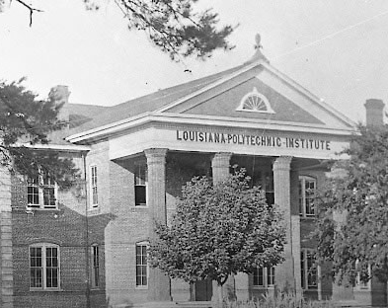
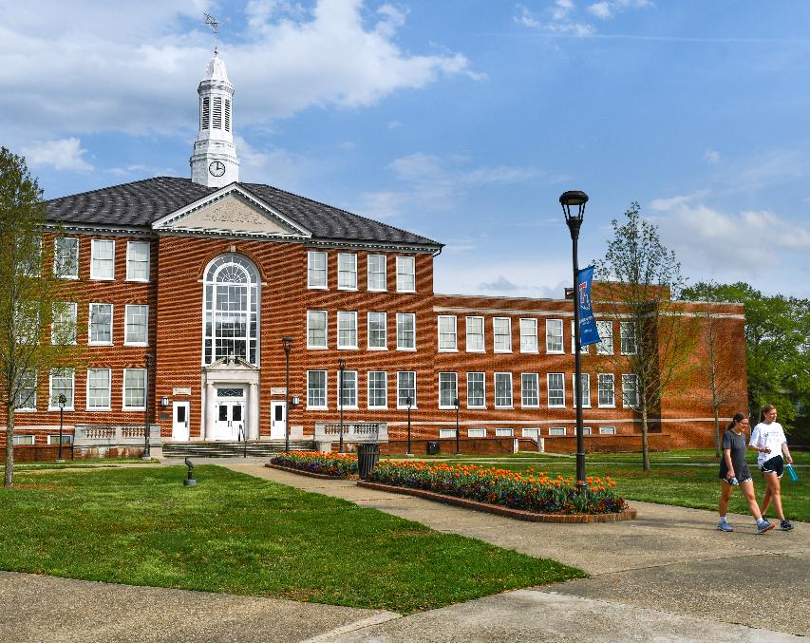
The first building constructed on Tech’s campus, Old Main, circa 1920’s. Contained eight classrooms, a lab, and offices and burned down in 1936.
Keeny Hall (originally name Leche Hall) replaced Old Main in 1937 and still stands today as one of the focal building bordering the Quad.

Slide 15
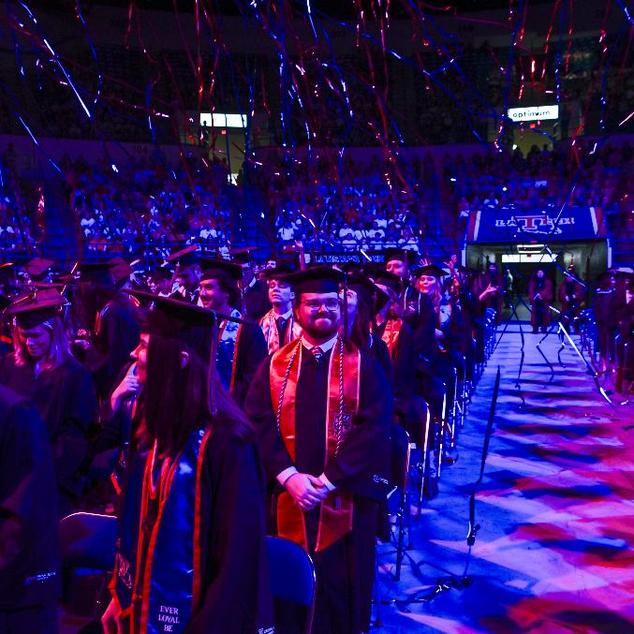
LOUISIANA TECH GRADUATION MILESTONES
1897 Tech grants its first bachelor’s degree to Harry Howard
1905 The Lagniappe, Tech’s annual yearbook, is first published.
1959 Tech grants its first Masters degrees.
1971 The first Doctor of Philosophy (PhD) in Chemical Engineering is conferred.
2007 Tech becomes the first university in the world to award a Bachelor of Science in Nanosystems Engineering.
2015 Tech becomes the first school in the country to award a Bachelor of Cyber Engineering.
2017 Louisiana Tech grants its 100,000th degree.
Today Tech’s adds 1,800+ new members to a growing alumni base of over 115,000 strong.

Slide 16
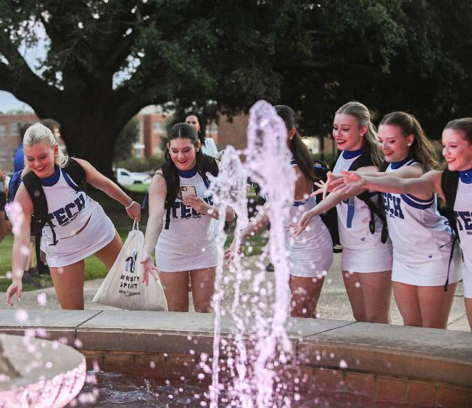
LOUISIANA TECH TRADITIONS
What is the role of traditions, rituals, and legends in a community and how do they aid in the development of interpersonal relationships?

Slide 17
THE TENETS OF TECH
CONFIDENCE
EXCELLENCE
COMMITMENT
KNOWLEDGE
INTEGRITY
RESPECT
LEADERSHIP
LOYALTY
ENTHUSIASM
CARING
HOPE
PRIDE
a sense of self
guidance through service, involvement, and responsibilities
appreciation for first-rate experiences
faithfulness to values, commitments, and responsibilities
acceptance of responsibility as a citizen of the university
excitement for personal characteristics and the future
understanding of ideas based on actual experiences
affinity for beauty, performing arts, and human culture
ability to defend, evaluate, or questions one’s own beliefs
belief in future experiences and growth opportunities
acknowledgement of others’ beliefs through personal interactions
a sense of self-respect

Slide 18
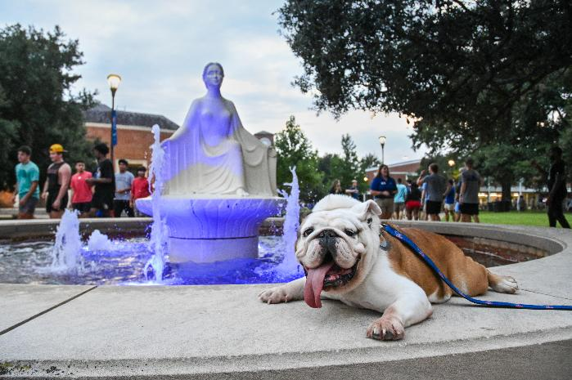

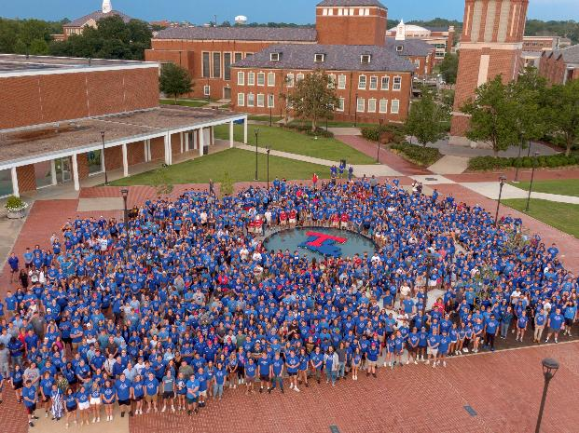
THE TENET MEDALLION & ACADEMIC CONVOCATION
Each year since 2007, the Academic Convocation welcomes students to campus the night before Fall classes to kick off their first year and their academic journey at Louisiana Tech. During the event, students are given a medallion engraved with the twelve tenets of Tech; which they later deposit into the Lady of the Mist signifying their commitment to the university and the path ahead. Students are then given a new tenet medallion at their graduation after receiving their diploma.

Slide 19

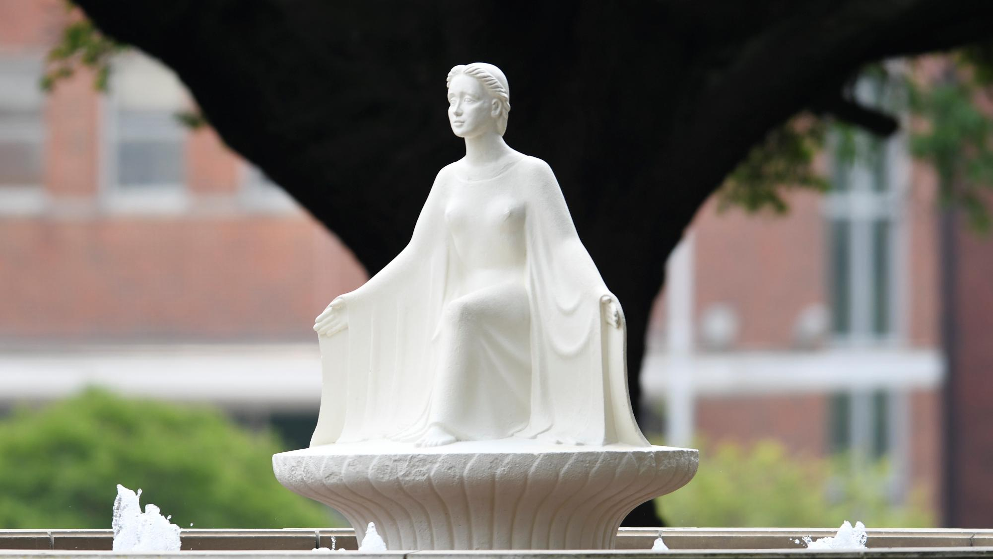
THE LADY OF THE MIST

Slide 20
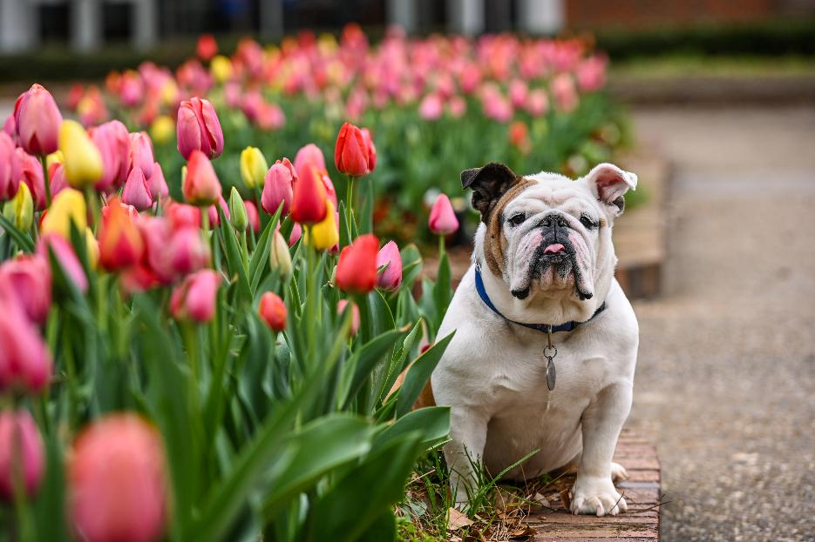
THE LEGEND OF THE BULLDOG
Fall of 1899, five Tech students stumble across a quiet bulldog under a tree. The bulldog follows them home and is allowed to stay for one night before other plans had to be made.
In the middle of the night, a fire breaks out and the old bulldog wakes up the residents by barking and tugging on sheets. In the process of saving many of the students, the bulldog sadly did not make it. Legend says he was buried on campus, wrapped in both a red and blue jacket.
A year later, as Tech began its athletics program, a mascot was needed, and the courageous bulldog was chosen to represent the university.

Slide 21
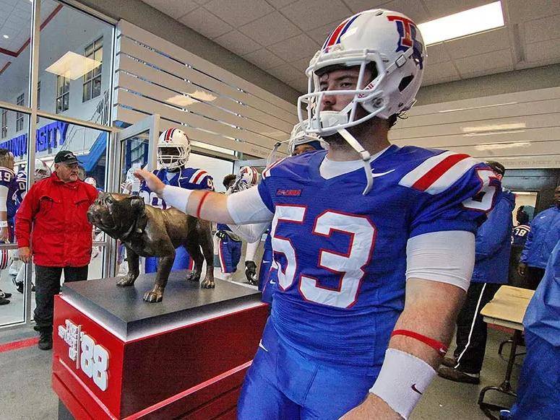
THE SPIRIT OF ‘88
1988 – The Bulldogs begin their move to Division I athletics by facing the nation’s 11th toughest football schedule with a Division II roster. Loses big but never gives up.
1989 – Statue commemorating the spirit of that 1988 team is commissioned and unveiled in South Endzone.
1989 – 1990 – Tech competes in Division I and begins seeing increased success on the field including an 18 home-game win streak and a birth in the Independence Bowl.
The legend spreads as three additional Spirit of ‘88 statues pop up in the student center, president’s office, and the Academic Success Center in Shreveport for all Tech students to experience the magic themselves.

Slide 22



LOYAL BLUE FRIDAYS
On Fridays, we wear BLUE!

Slide 23

FIGHT SONG by James Alvey Smith
ALMA MATER by John P. Graham
Fight! Fight! Fight! For ole red and blue!
Show your might and we’ll root for you!
Get on your toes when you meet your foes,
And don’t let them break through!
TECH! TECH! TECH!
Hit those lines like good ole canines!
Break through for a touchdown or two!
Hold up your chin and let’s all go in
To win for the red and blue!
O Tech, thy halls so beautiful,
Thy pleasant walks, thy noble trees,
That charmed me in my college days,
Are ever dear to me.
Louisiana Tech, I love thee,
My Alma Mater, My Alma Mater,
I will ever loyal be
To thee, my Alma Mater.

Slide 24
Why Tech? (Activity 3.2)
Why did you choose to go to college? What about Louisiana Tech specifically? List a few reasons for each. Which are the most important? Why?

